Slide 1


Sudhesh Solomon
10/30/2023

Slide 2

Outline
Executive Summary
Introduction
Methodology
Results
Conclusion
Appendix

Slide 3
Executive Summary
Summary of methodologies
Data Collection through API
Data Collection using Web Scraping
Data Wrangling
Exploratory Data Analysis using SQL, and Pandas
Visual Analytics using Folium and dashboard analytics using Plotly
Machine Learning Algorithms
Summary of all results
Exploratory Data Analysis results
Machine Learning Algorithms for Space X – a comparative report

Slide 4
Introduction
Project background and context
Space X advertises Falcon 9 rocket launches on its website with a cost of 62 million dollars; other providers cost upward of 165 million dollars each, much of the savings is because Space X can reuse the first stage. Therefore, if we can determine if the first stage will land, we can determine the cost of a launch. This information can be used if an alternate company wants to bid against space X for a rocket launch. This goal of the project is to create a machine learning pipeline to predict if the first stage will land successfully.
Problems you want to find answers
Factors that determine successful landing
Correlation between features that determine if the landing will be successful or not.
Operating conditions for successful landing

Slide 5

Section 1

Slide 6
Methodology
Executive Summary
Data collection methodology:
Data was collected using SpaceX API and web scraping from Wikipedia
Perform data wrangling
Applied one-hot encoding to the categorical features
Perform exploratory data analysis (EDA) using visualization and SQL
Perform interactive visual analytics using Folium and Plotly Dash
Perform predictive analysis using classification models
Split the train and test dataset into 80% for training and 20% for testing.
Build the model and test with various combinations of hyperparameters using Grid Search.

Slide 7
Data Collection
Describe how data sets were collected.
The requests module was used to collect data from the SpaceX API.
The response was obtained as a JSON and saved into a dataframe using json_normalize method.
Data Cleaning was performed to handle missing values.
Additionally, BeautifulSoup module was used to scrape data for Falcon 9 launch records

Slide 8
Data Collection – SpaceX API
Collect SpaceX launch data from SpaceX API
This dataset gives information about launch, including rocket used, payload delivered, landing outcome, etc.
The URL of the endpoint is of the format api.spacexdata.com/v4/
Falcon 9 launch data was obtained by web scraping Wikipedia using BeautifulSoup.
Returns data in JSON
SpaceX REST API
Normalize into CSV
Extract data from BeautifulSoup
Get HTML response from Wikipedia
Normalize into CSV

Slide 9
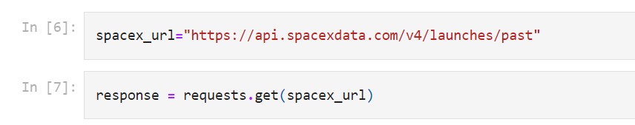
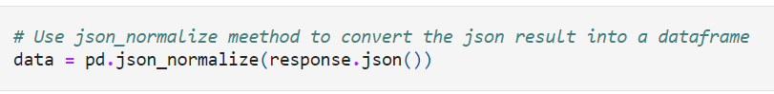
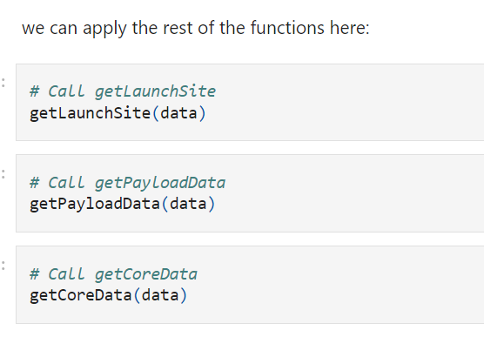
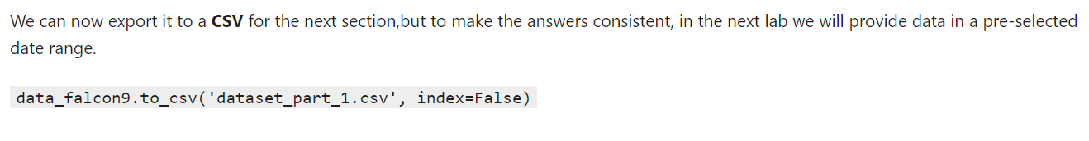
Data Collection - Scraping
Data Collection using SpaceX REST API
Link to Github is https://github.com/SudheshSolomon1992/IBM-Data-Science-Professional-Certificate/blob/master/Capstone/jupyter-labs-spacex-data-collection-api.ipynb

Slide 10
Data Wrangling
Data wrangling steps
Check and handle null values
Calculate the number of launches on each site
Calculate the number of occurances of each orbit
Calculate the number of occurances of mission outcome per orbit type
Create landing outcome label
Github URL is https://github.com/SudheshSolomon1992/IBM-Data-Science-Professional-Certificate/blob/master/Capstone/labs-jupyter-spacex-Data%20wrangling.ipynb
EDA
Summarization
Create Landing Outcome Label

Slide 11
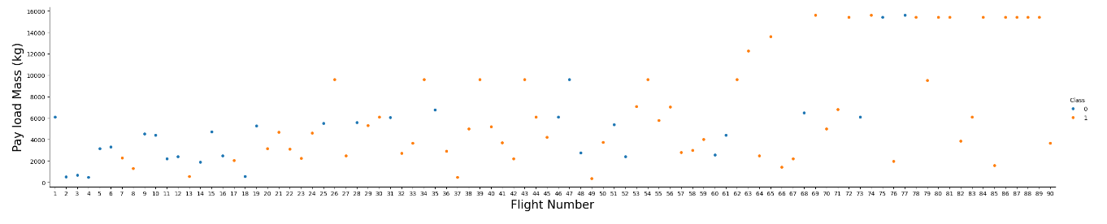
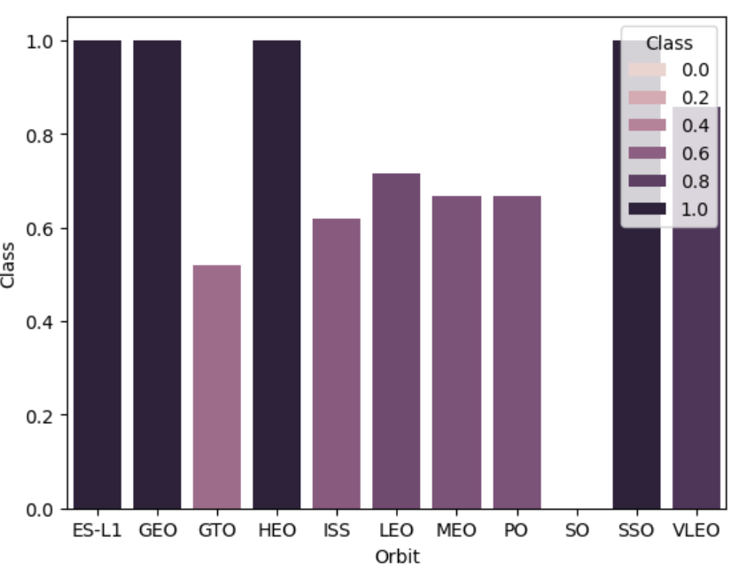
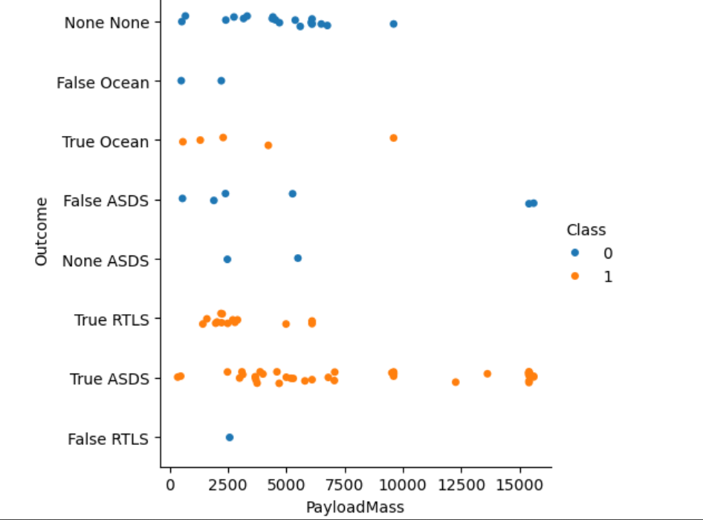
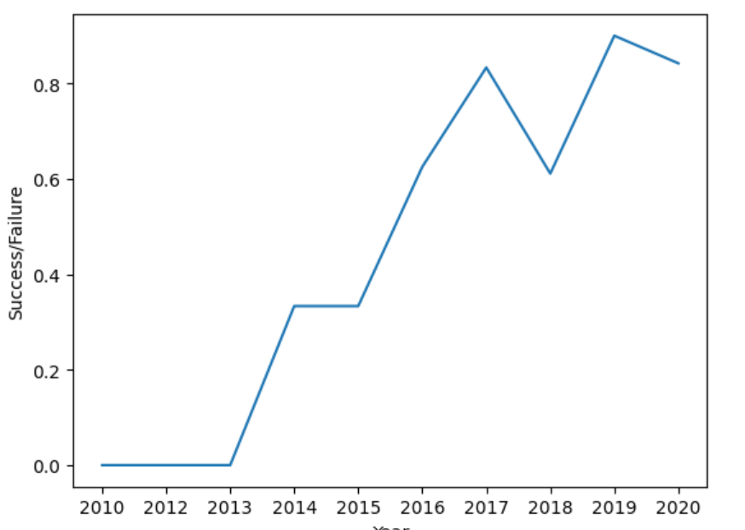
EDA with Data Visualization
Github URL: https://github.com/SudheshSolomon1992/IBM-Data-Science-Professional-Certificate/blob/master/Capstone/IBM-DS0321EN-SkillsNetwork_labs_module_2_jupyter-labs-eda-dataviz.ipynb.jupyterlite.ipynb

Slide 12
EDA with SQL
Queries included
Finding the unique launch sites in the space mission.
Listing top 5 launch sites with name beginning with the string 'CCA'.
Calculating total payload_mass carried by boosters launched by NASA (CRS).
Calculating average payload_mass carried by booster version F9 v1.1.
Finding the date when the first landing outcome in ground pad was achieved.
Listing the names of the boosters which had success in drone ship and payload_mass ranged between 4000 kg to 6000 kg.
Finding the total number of successful and failure mission outcomes.
Finding the names of the booster versions which had carried the maximum payload_mass.
Listing the records which will display the month names, failure landing_outcomes in drone ship ,booster versions, launch_site for the months in year 2015.
Ranking the count of landing outcomes (such as Failure (drone ship) or Success (ground pad)) between the date 2010-06-04 and 2017-03-20, in descending order.
Github URL: https://github.com/SudheshSolomon1992/IBM-Data-Science-Professional-Certificate/blob/master/Capstone/jupyter-labs-eda-sql-coursera_sqllite.ipynb

Slide 13
Build an Interactive Map with Folium
Markers, circles, lines, and marker clusters were used.
Launch sites have been indicated by markers.
Highlighted areas around specific coordinates like NASA Johnson Space Center have been indicated by circles.
Group of events in each coordinate like launches in the launch site have been indicated using marker clusters.
Distance between two coordinates have been indicated using lines.
Github URL: https://github.com/SudheshSolomon1992/IBM-Data-Science-Professional-Certificate/blob/master/Capstone/IBM-DS0321EN-SkillsNetwork_labs_module_3_lab_jupyter_launch_site_location.jupyterlite.ipynb

Slide 14
Build a Dashboard with Plotly Dash
Interactive dashboard was built using Plotly Dash.
Pie charts were plotted to show total launches by certain sites.
Scatter graphs were created to show the relationship with outcome and payload_mass (kg) for different booster version.
Github URL: https://github.com/SudheshSolomon1992/IBM-Data-Science-Professional-Certificate/blob/master/Capstone/spacex_dash_app.py

Slide 15
Predictive Analysis (Classification)
Data was loaded using numpy, pandas.
It was then transformed and split into training and test dataset.
Various machine learning models were developed and hyper-parparameters for those models were tuned using GridSearchCV.
The best performing model was determined from the results of the prediction.
Github URL: https://github.com/SudheshSolomon1992/IBM-Data-Science-Professional-Certificate/blob/master/Capstone/IBM-DS0321EN-SkillsNetwork_labs_module_4_SpaceX_Machine_Learning_Prediction_Part_5.jupyterlite.ipynb

Slide 16
Results
SpaceX used 4 different launch sites.
The average payload mass for F9 v1.1 was 2,928 kg.
The first successful landing outcome happened in 2015 which was 5 years after the first launch.
Many Falcon9 booster versions were successful at landing drone ships having payload_mass above the average value.
Two booster versions failed at landing drone ships in 2015.
The landing outcomes became better as the years passed.

Slide 17

Section 2

Slide 18
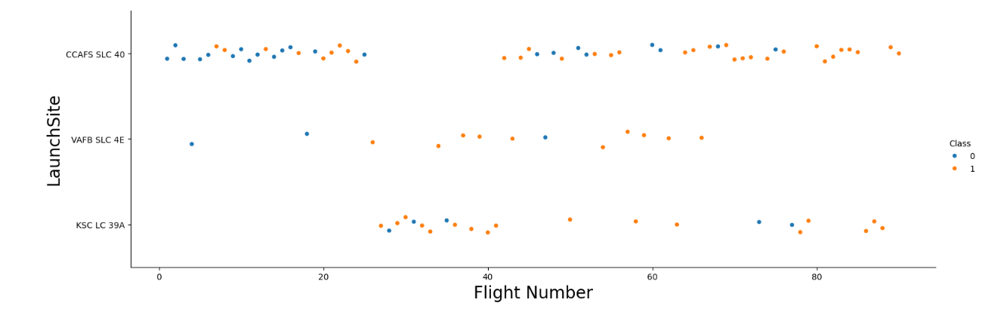
Flight Number vs. Launch Site
Inference: Larger the flight amount at the launch site, greater is the success rate.

Slide 19
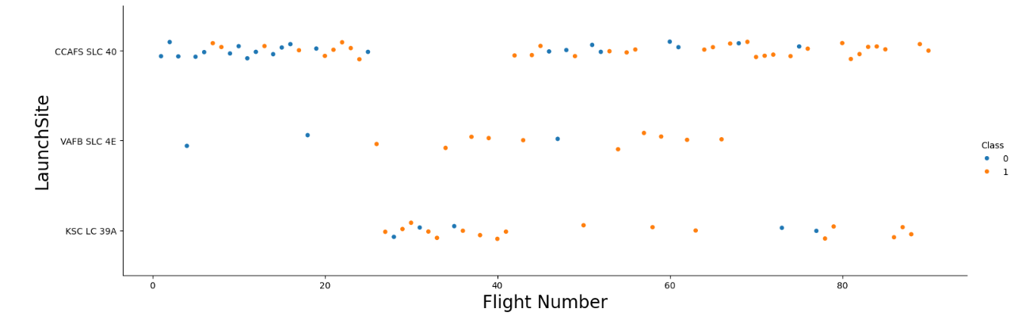
Payload vs. Launch Site
Inference: Greater the payload_mass for CCAFS SLC40 the higher the success rate.

Slide 20
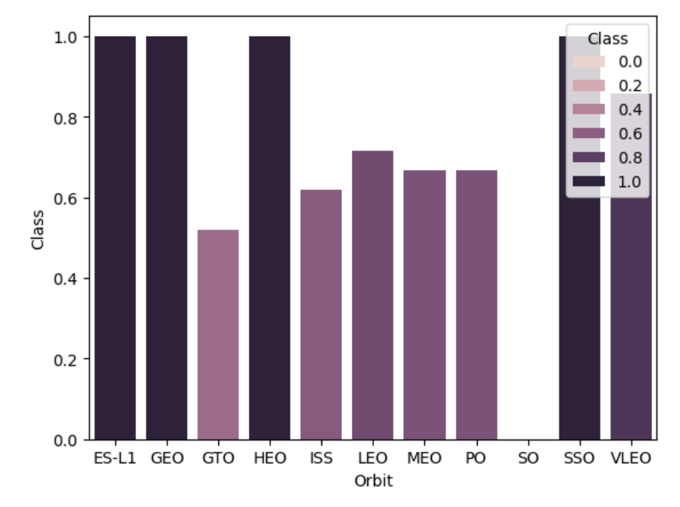
Success Rate vs. Orbit Type
The highest success were achieved by ES-L1, GEO, HEO, SSO, and VLEO

Slide 21
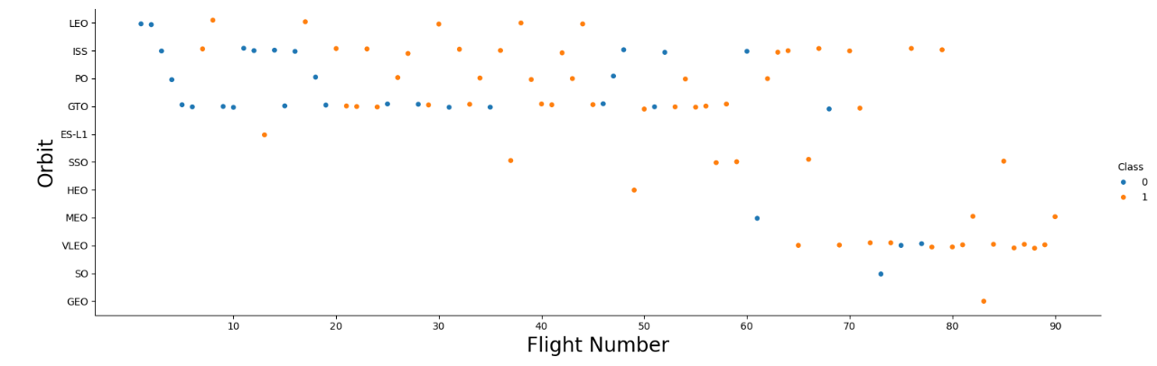
Flight Number vs. Orbit Type
Inference: Higher success is found in LEO and VLEO with increase in the number of flights.

Slide 22
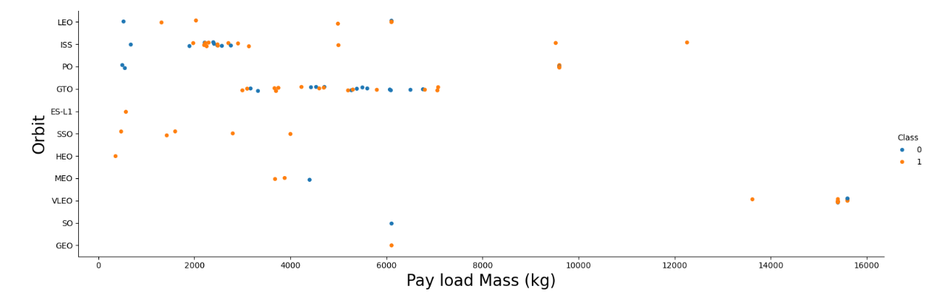
Payload vs. Orbit Type
Inference: Higher payload result in successful landing for PO, LEO, and ISS orbits

Slide 23
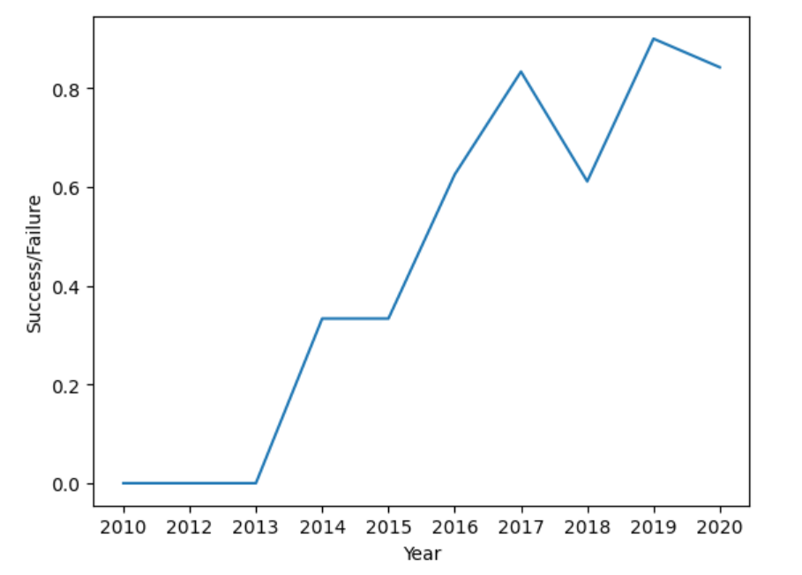
Launch Success Yearly Trend
Inference: Success rate is increasing but there was a sharp decline in 2018 after which I again started increasing

Slide 24
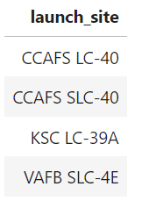
All Launch Site Names
Query: %sql select Unique(LAUNCH_SITE) from SPACEXTBL;

Slide 25
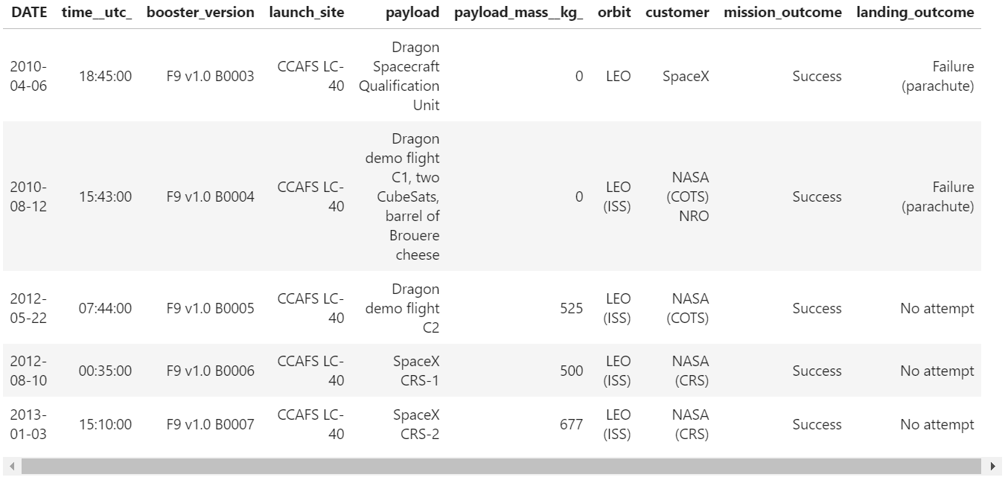
Launch Site Names Begin with 'CCA'
Query: %sql select * from SPACEXTBL where lower(launch_site) like 'cca%' limit 5;

Slide 26
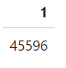
Total Payload Mass
Query: %sql SELECT SUM(PAYLOAD_MASS__KG_) \ FROM SPACEXTBL \ WHERE CUSTOMER = 'NASA (CRS)';

Slide 27
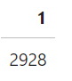
Average Payload Mass by F9 v1.1
Query: %sql SELECT AVG(PAYLOAD_MASS__KG_) \ FROM SPACEXTBL \ WHERE BOOSTER_VERSION = 'F9 v1.1'

Slide 28
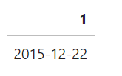
First Successful Ground Landing Date
Query: %sql SELECT MIN(DATE) \ FROM SPACEXTBL \ WHERE LANDING_OUTCOME = 'Success (ground pad)'

Slide 29
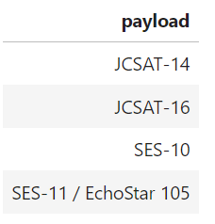
Successful Drone Ship Landing with Payload between 4000 and 6000
Query: %sql SELECT PAYLOAD \ FROM SPACEXTBL \ WHERE LANDING_OUTCOME = 'Success (drone ship)' \ AND PAYLOAD_MASS__KG_ BETWEEN 4000 AND 6000;

Slide 30
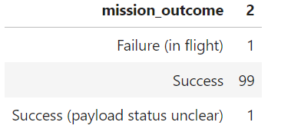
Total Number of Successful and Failure Mission Outcomes
Query: %sql SELECT MISSION_OUTCOME, COUNT(*) \ FROM SPACEXTBL \ GROUP BY MISSION_OUTCOME

Slide 31
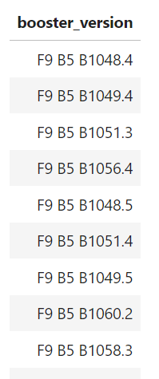
Boosters Carried Maximum Payload
Query: %sql SELECT BOOSTER_VERSION \ FROM SPACEXTBL \ WHERE PAYLOAD_MASS__KG_ = (SELECT MAX(PAYLOAD_MASS__KG_) FROM SPACEXTBL);

Slide 32

2015 Launch Records
Query: %sql SELECT substr(Date,4,2) as month, DATE,BOOSTER_VERSION, LAUNCH_SITE, LANDING_OUTCOME \ FROM SPACEXTBL \ where LANDING_OUTCOME = 'Failure (drone ship)' and substr(Date,7,4)='2015';

Slide 33
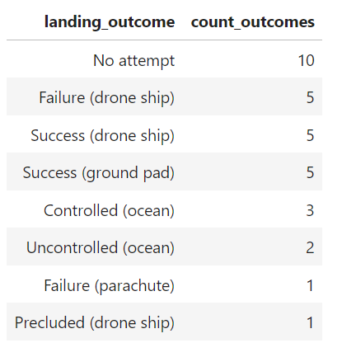
Rank Landing Outcomes Between 2010-06-04 and 2017-03-20
Query: %sql SELECT LANDING_OUTCOME, count(*) as count_outcomes \ FROM SPACEXTBL \ WHERE DATE between DATE '2010-06-04' and DATE '2017-03-20' \ group by LANDING_OUTCOME \ order by count_outcomes DESC;

Slide 34

Section 3

Slide 35
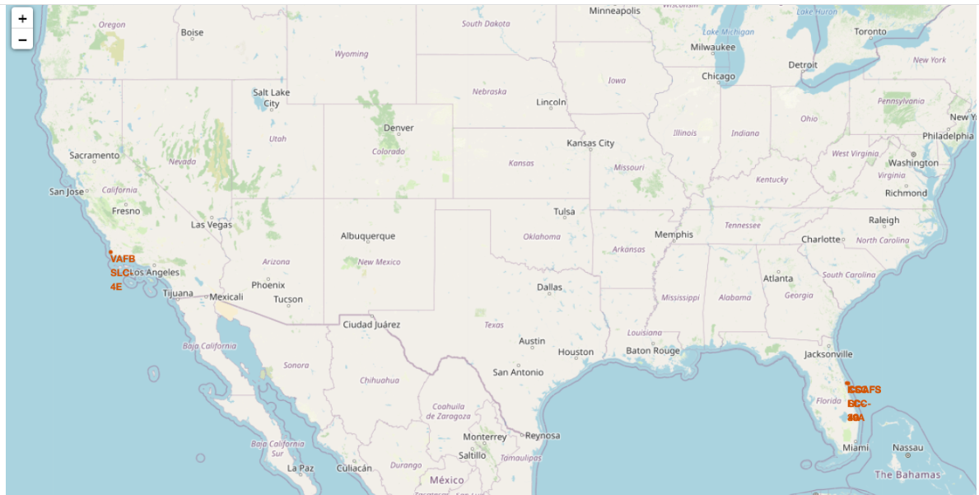
All Launch Sites Global Markers

Slide 36
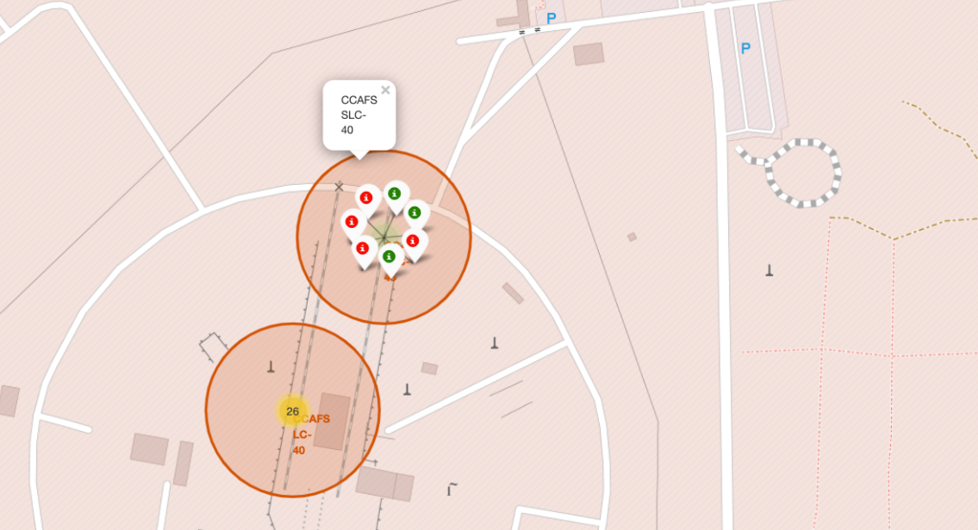
Markers showing outcomes with color labels
Green markers depict successful launches while red markers denote failed launches.

Slide 37
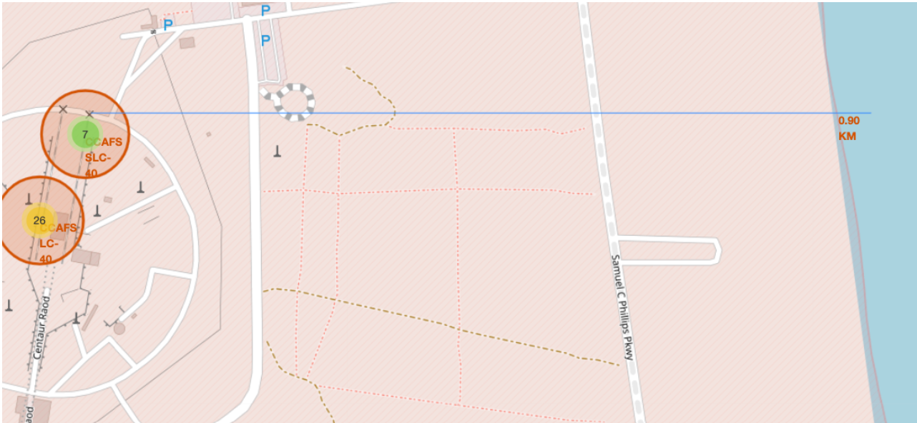
Launch Site Distance to Coast
The figure below depicts the distance to coast from the launch site.

Slide 38

Section 4

Slide 39
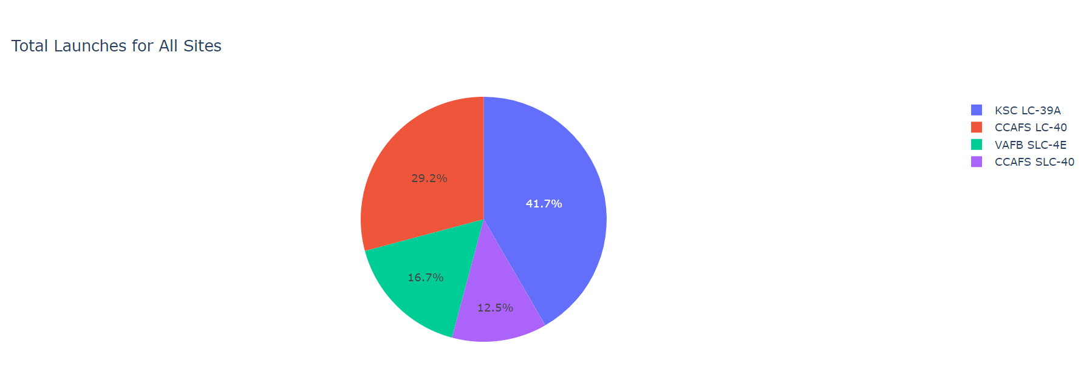
Success Percentage per Launch Site
We can see that KSC LC-39A had the most successful launches among all the sites.

Slide 40
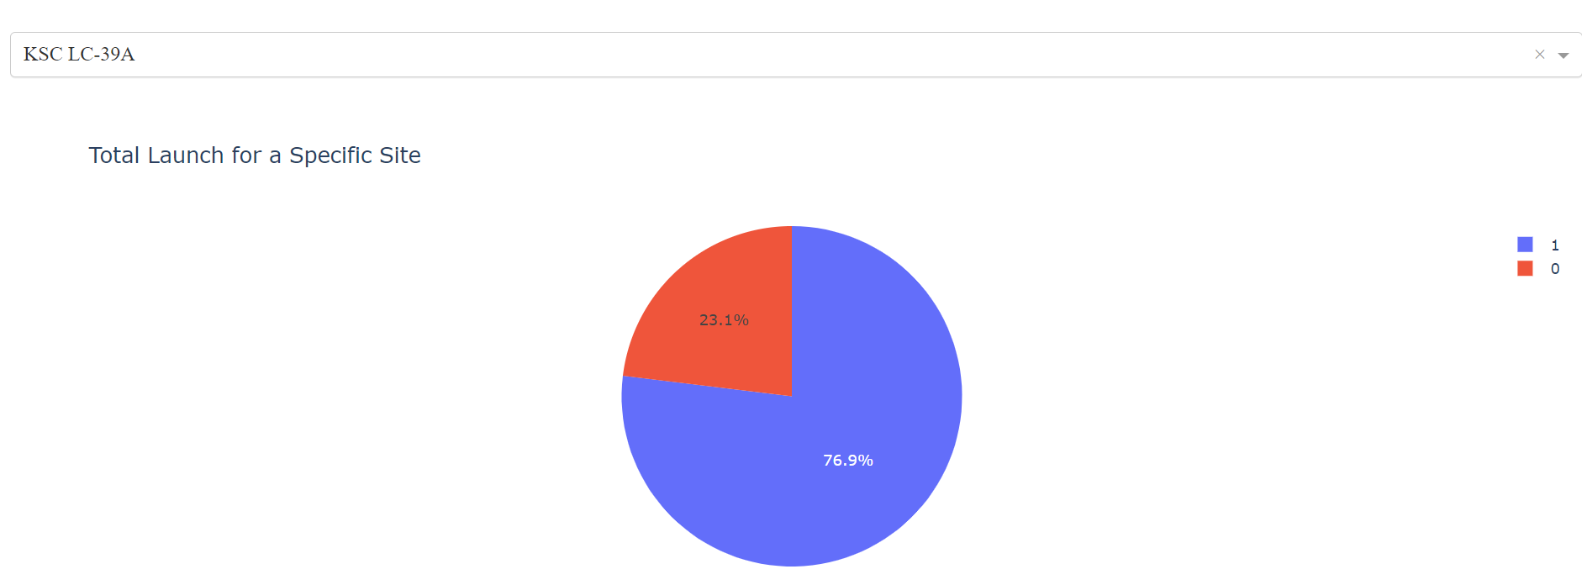
<Dashboard Screenshot 2>
KSC LC-39A achieved a 76.9% success and a 23.1% failure rate

Slide 41
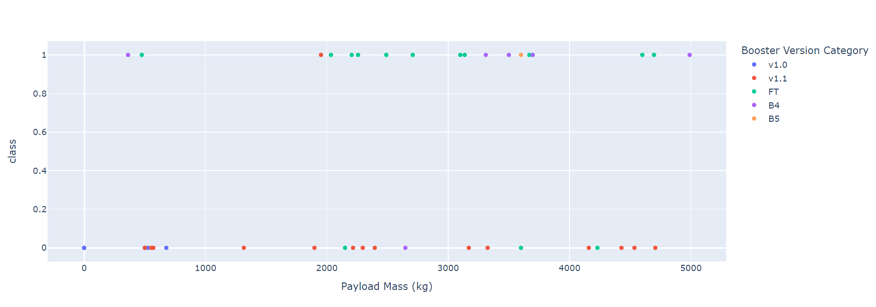
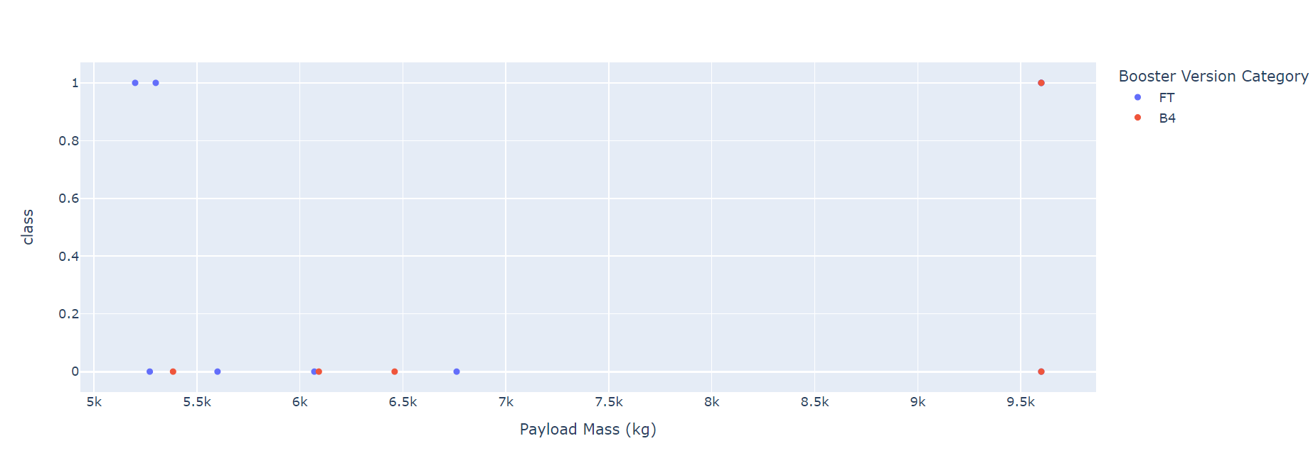
Payload vs Launch Outcomes for all sites
Success rates of low weighted payloads (0 – 5000 kg) vs high weighted payloads (5000kg – 10000 kg)

Slide 42

Section 5

Slide 43
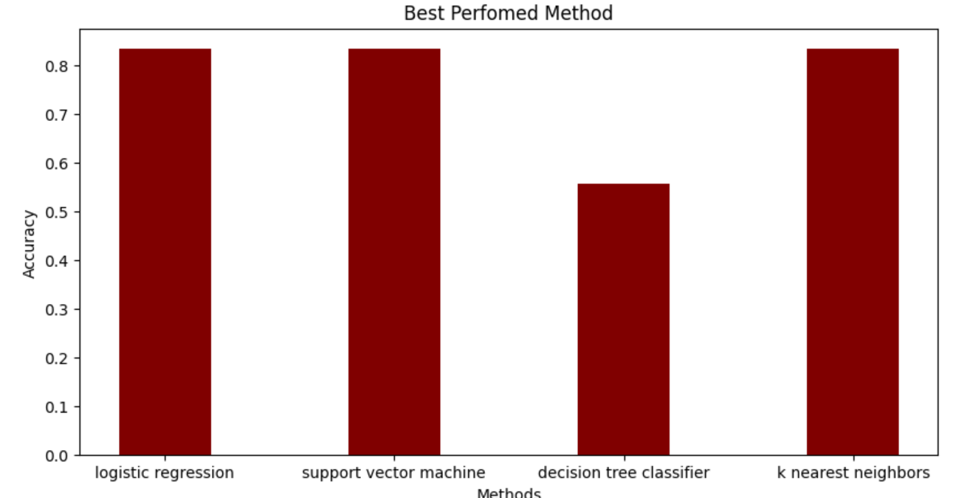
Classification Accuracy
SVM, Logistic Regression, and KNN achieved almost nearly the same accuracy of 83%.

Slide 44
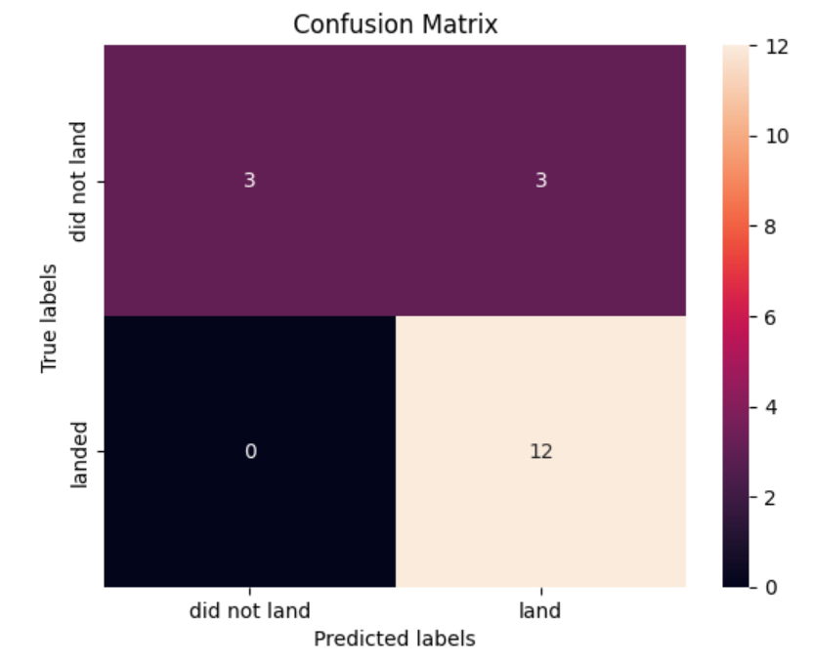
Confusion Matrix
Shown here is the confusion matrix of KNN.

Slide 45
Conclusions
Greater the number of flights at the launch site, greater the success rate.
The launch success rate started to gradually increase from 2013.
Orbits ES-L1, GEO, HEO, SSO, VLEO had the most success.
KSC LC-39A was the most successful launch site in terms of successful launches.
The KNN was the best performing algorithm achieving nearly 84% accuracy.

Slide 46
Appendix
Include any relevant assets like Python code snippets, SQL queries, charts, Notebook outputs, or data sets that you may have created during this project

Slide 47


